Slide 1
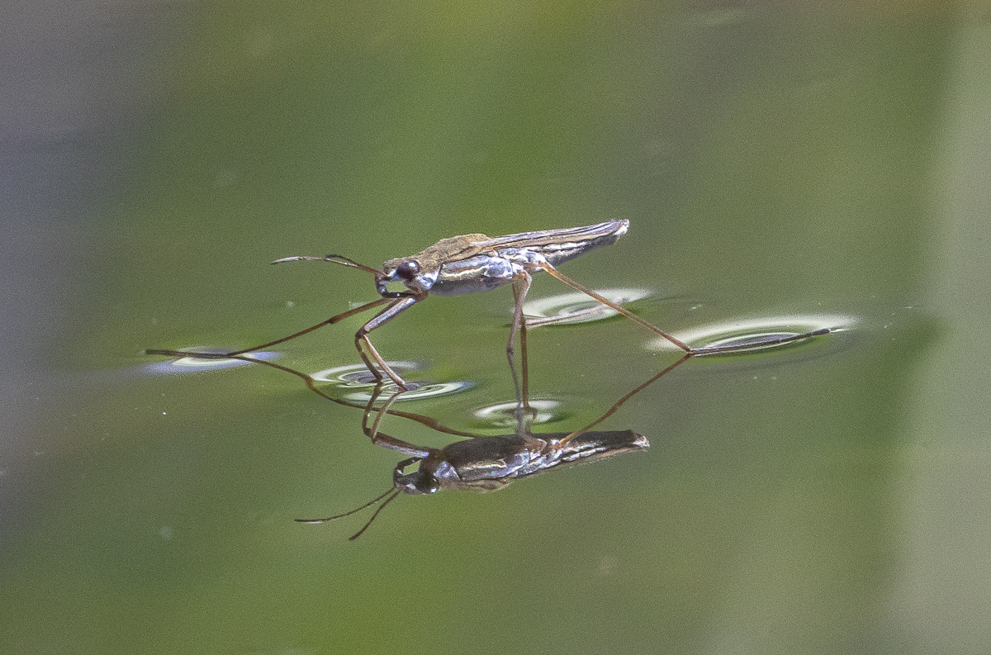
Question 1
Material with high specific surface area is favorable in catalysis, energy storage, and environmental applications.
Can you suggest some strategy to create high specific surface area?
What are the potential drawbacks of using materials with high specific surface area in the reactions?
Question 2
Polystyrene nanoparticles tends to aggregate in the suspension, due to strong van der Waals attraction.
Can you propose some strategy to prevent the aggregation?
Question 3
Q1. You see a water strider walking on water. Why doesn’t it sink?
Q2. Does buoyancy explain why the strider floats?
Q3. Why are the legs so effective at staying dry?
Q4. What happens at the molecular level at the leg–water interface?
Q5. What do we see instead of penetration of the legs?
Q6. Where do we apply the same principles in technology?
https://roadsendnaturalist.com/wp-content/uploads/2022/05/water-strider-on-dark-background.jpg

Slide 2
Question 1
Material with high specific surface area is favorable in catalysis, energy storage, and environmental applications.
Can you suggest some strategy to create high specific surface area?
What are the potential drawbacks of using materials with high specific surface area in the reactions?
Strategy to create high specific surface area
Reduction of particle size
Porous structure
Etching/surface roughness
Potential drawbacks
Thermal stability – Aggregation/Sintering
Mechanical stability
Limited mass/heat transport
High consumption rate

Slide 3
Question 2
Polystyrene nanoparticles tends to aggregate in the suspension, due to strong van der Waals attraction.
Can you propose some strategy to prevent the aggregation?
Non-polar solvent (for example, n-hexane)
Using surfactants – hydrophobic tails of surfactants adsorbed onto polystyrene particles surface, exposing the hydrophilic heads of surfactants to water (like a protecting shell)
Surface charge modification – increasing particle surface charge density by adding charged functional groups; isolating the particles by electrostatic repulsion

Slide 4
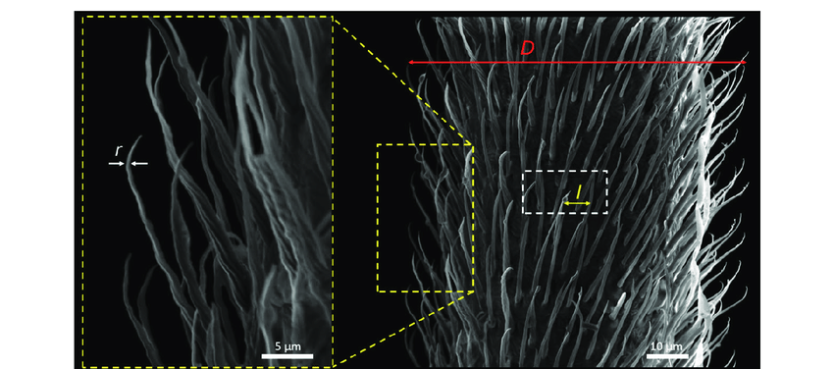
Question 3
A1. Because of surface tension: hydrogen bonds between water molecules create a strong cohesive skin at the air–water interface that resists penetration.
A2. No. The insect is too light; Archimedes’ buoyancy force is negligible. The support comes mainly from capillary forces along the deformed interface.
A3. They are covered with micro- and nanostructured hairs (like microvilli) coated in wax, making them superhydrophobic. Water can’t wet them, and the contact angle is very high.
A4. Hydrophobic coatings reduce van der Waals attraction to water, while water prefers to H-bond with itself. The result: water is excluded, and the leg presses down without penetrating, creating visible dimples.
A5. The water surface bends downward (concave meniscus) but remains intact — capillary forces hold the leg up.
10.2494/photopolymer.33.185

Slide 5
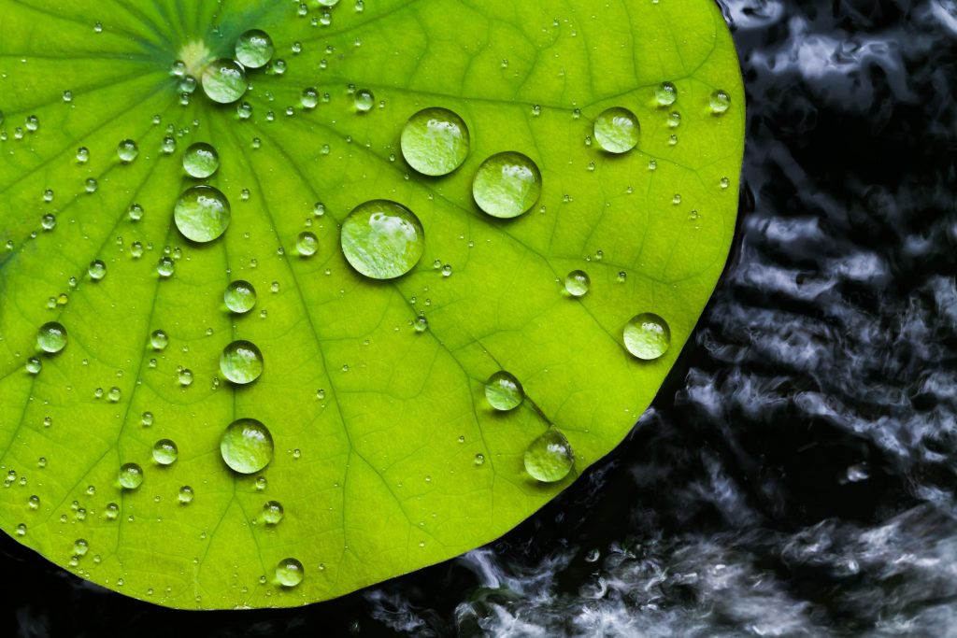
A6.
- superhydrophobic coatings (self-cleaning “lotus effect”). The lotus effect is the phenomenon where water droplets roll off a lotus leaf, carrying dirt with them
- antifouling surfaces (materials engineered to prevent organisms from sticking and growing on them, especially in aquatic environment),
- drag-reducing ship hulls
- microfluidics, where control of wetting and capillary forces is critical.
https://www.properla.co.uk/lotus-effect/

